Slide 1




Slide 2

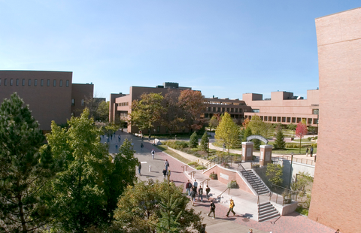
About us...
First private educational institution in Croatia (1997) offering dually accredited degrees:
  An American degree from RIT (Bachelor of Science degree)
  Croatian degree from RIT Croatia (Bologna Accord approval) 240 ECTS
A division of Rochester Institute of Technology, Rochester, NY, USA
All classes in English

Slide 3







RIT - rankings and recognitions
Program accredited by:
Middle States Commision on Higher Education
Middle States Association of Colleges and Schools
Ministry of Science, Education and Sport, Croatia

Slide 4

RIT Croatia – undergraduate programs
International Business
International Hospitality and Service Management
Information Technology
+ You can take Digital Business minor within all three programs!
All programs are fully alligned with the programs at RIT in Rochester!

Slide 5
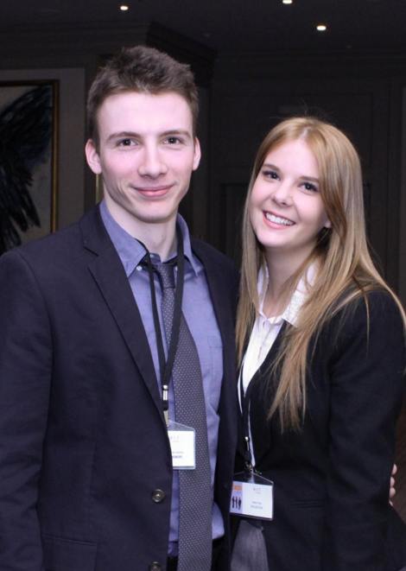

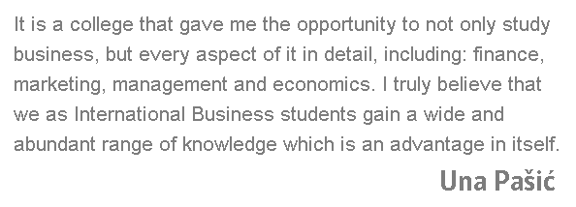
RIT Croatia – undergraduate programs
International Business – Zagreb
    Marketing minor
    Management minor
    Finance minor

Slide 6

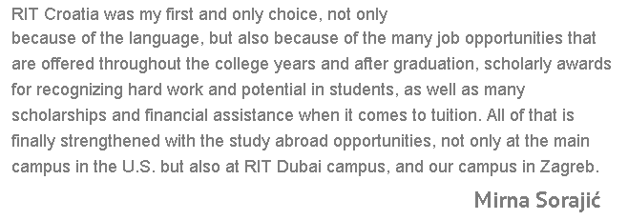
RIT Croatia – undergraduate programs
International Hospitality and Service Management – Dubrovnik
    International Hotel and Resort Management
    Entrepreneurship

Slide 7
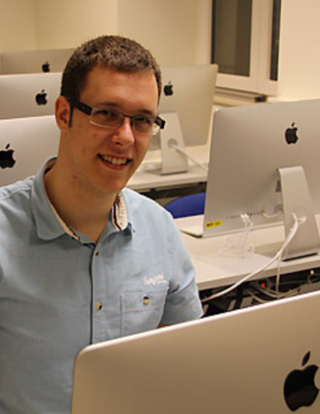
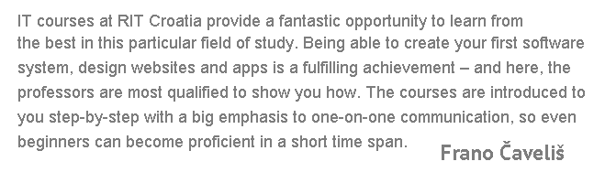
RIT Croatia – undergraduate programs
Information Technology (Web and Mobile Computing) – Dubrovnik and Zagreb
    Mobile Application Development
    Web Application Development

Slide 8
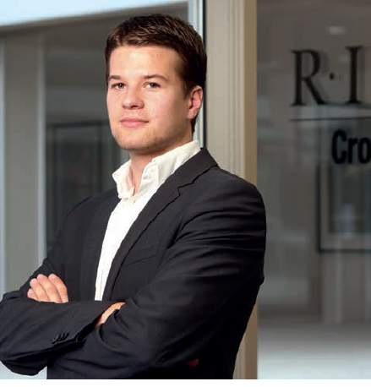
Cooperative Education
Learning how to apply theoretical knowledge in the real business world
RIT has the fourth-oldest and one of the largest cooperative education programs in the world, annually placing more than 4,100 students in more than 6,100 co-op assignments with more than 2,100 employers across the USA and overseas
RIT Croatia graduates have conducted more than 300 years of internship for more than 3,000 companies !

Slide 9



















Cooperative Education

Slide 10
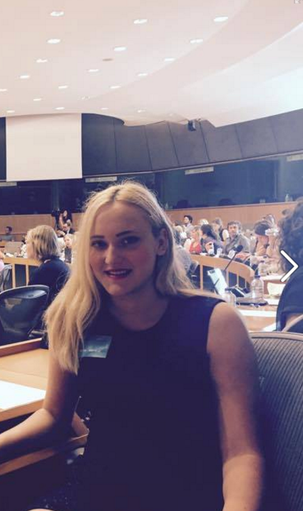

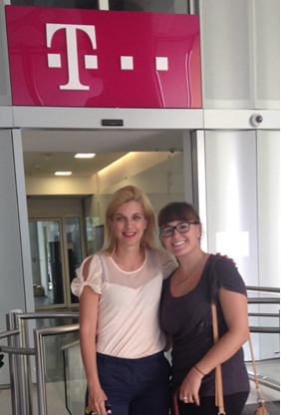

Cooperative Education
Brussels
New York
Zagreb

Slide 11
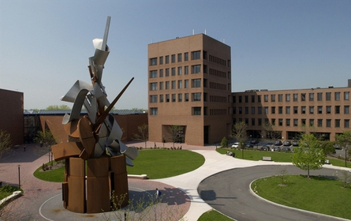
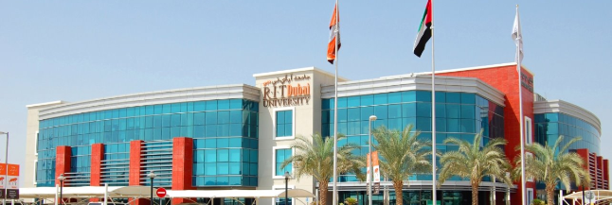

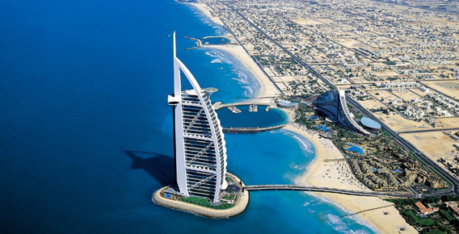
Study abroad
opportunity to attend one semester at RIT’s main campus, located in Rochester, N.Y., or at the RIT Dubai campus, located in the UAE.
Rochester, N.Y. Dubai, UAE

Slide 12
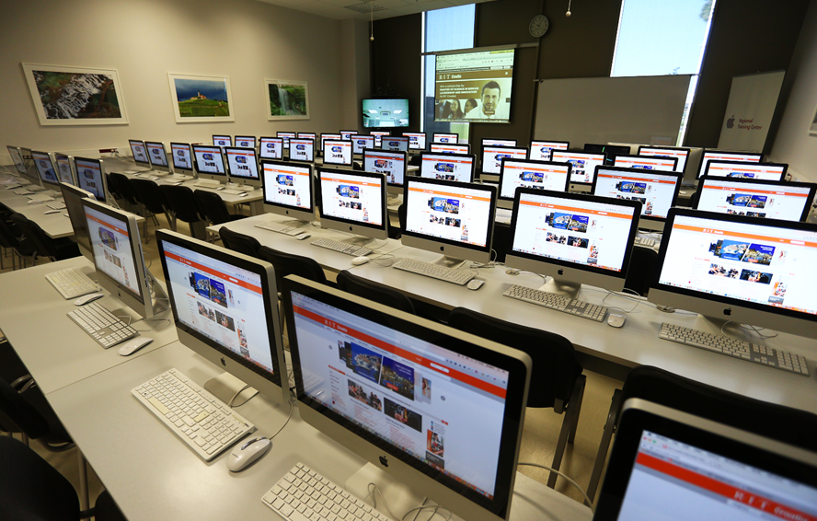
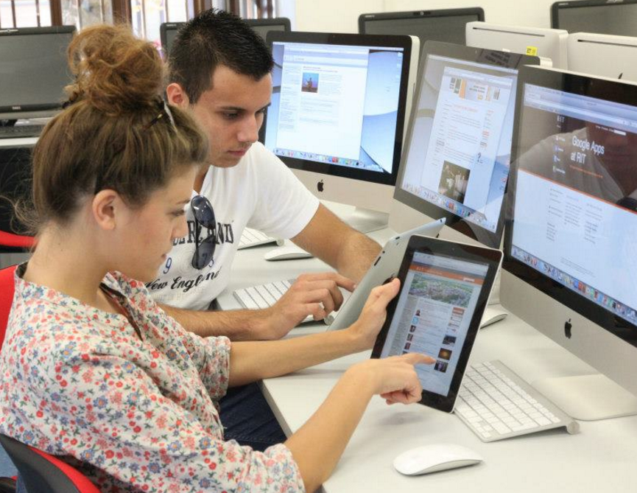
RIT Croatia – Institute of Technology!
Apple Regional training center
254 computers, 30 iPad’s, state of the art video conferencing equipment – Polycom HD and CISCO

Slide 13

www.croatia.rit.edu
65% of our students study with the help of scholarship and financial support!
Tuition for 2016/2017 - 6.100,00 EUR
This year the Scholarships/Financial Aid fund is 350.000,00 EUR
  Merit based (ELC, Entrance exam, Excellence)
  Need based (Financial aid)
  Motivational scholarship (End of year)
DON’T MISS THE EARLY ADMISSIONS DEADLINE: DECEMBER 15th!!

Slide 14
BECOME OUR STUDENT FOR A DAY!
Dubrovnik Campus
Don Frana Bulića 6
20000 Dubrovnik
Hrvatska / Croatia
Phone: + 385 (0) 20 433 000
Fax: + 385 (0) 20 433 001
Zagreb Campus
Damira Tomljanovića Gavrana 15
10000 Zagreb
Hrvatska / Croatia
Phone: + 385 (0) 1 643 9100
Fax: + 385 (0) 1 643 9103
e-mail: admissions@croatia.rit.edu
www.croatia.rit.edu

Slide 15
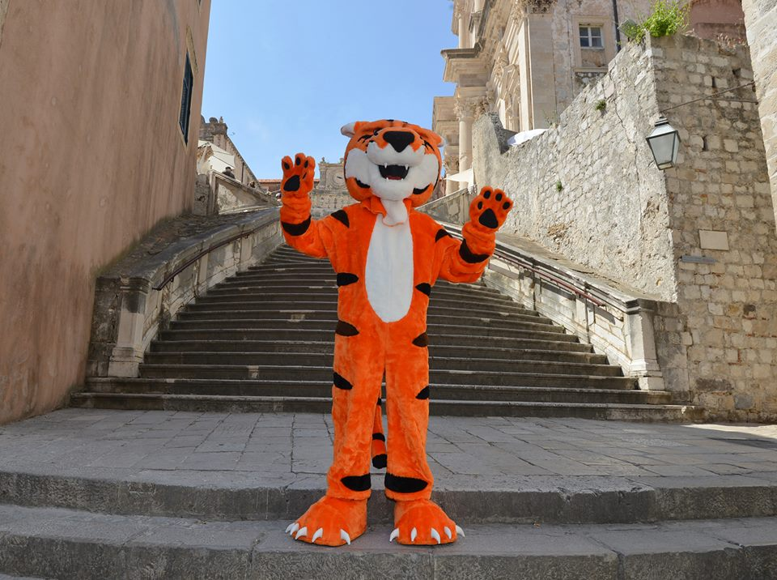
THANK YOU FOR YOUR ATTENTION!

